Slide 1

Section 11.6 Absolute Convergence and the Ratio and Root Tests
Lecture 1
Absolute and Conditional Convergence

Slide 2

Section Homework Submission to Canvas
Preview of section​
Skim section, write short paragraph summary, list all important definitions / theorems / formulas.​
Notes on video lectures​
Include all details, worked examples, your own thoughts​
Worked examples from text​
Solutions to exercises​
Final reflection of section​
List of key takeaways to remember​

Slide 3
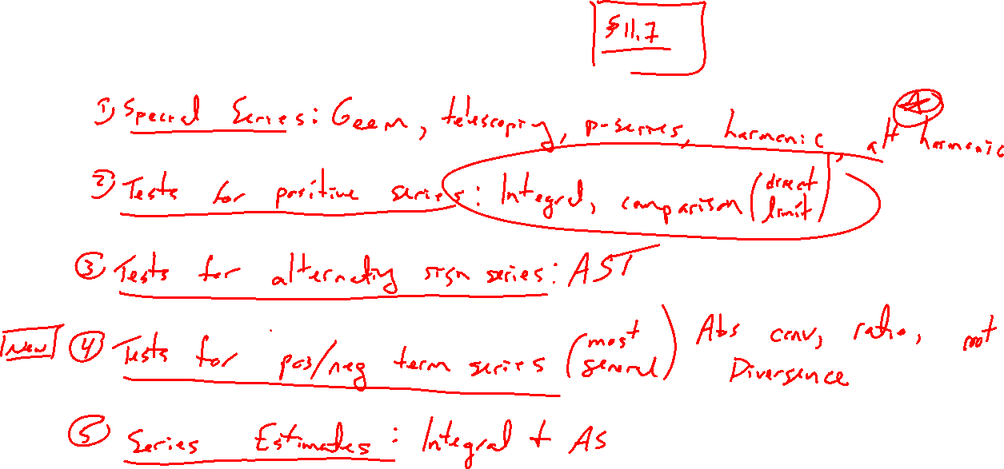
Summary of Results So Far
Notes:
Special series: geom, teles, harmonic, p
Tests for series with pos terms: div, integral direct comparison / limit comparison
Test for series with alternating sign: alt ser test
Tests for series with pos and neg terms (but not alternating)
Estimates: integral, alt ser test

Slide 4
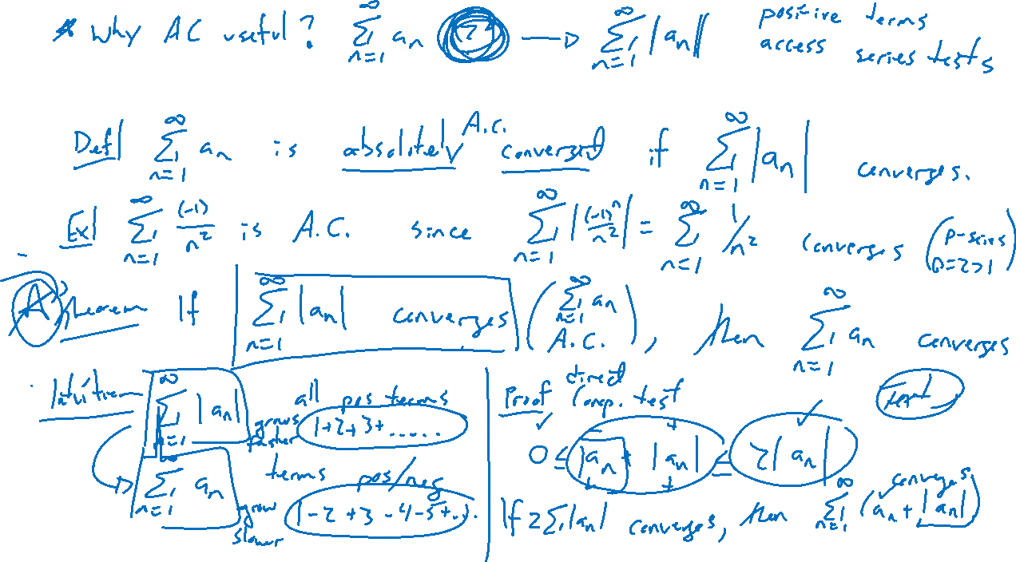
Absolute Convergence: Definition and Theorem
Notes:
Def: \sum a_n is absolutely convergent if \sum |a_n| converges
Theorem: If a series converges absolutely, then it converges
Reason: \sum a_n must go to zero faster than \sum |a_n|
Proof: Comparison test: 0 \leq a_n + |a_n| \leq 2|a_n|
And \sum a_n = \sum (a_n + |a_n|) - \sum |a_n|
Why important: Makes a series positive to access other series tests

Slide 5
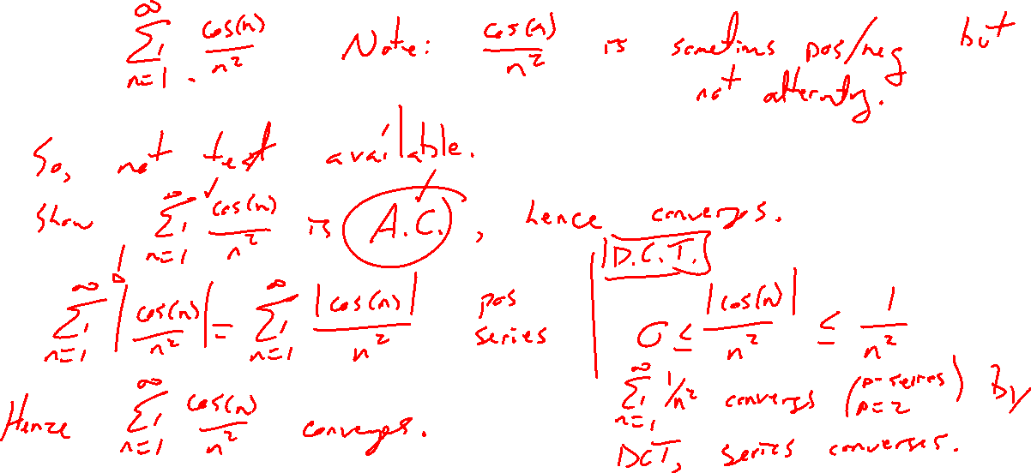
Absolute Convergence: Example
Notes:
\sum \cos(n) / n^2
Show in desmos not alternating
No other method applies

Slide 6
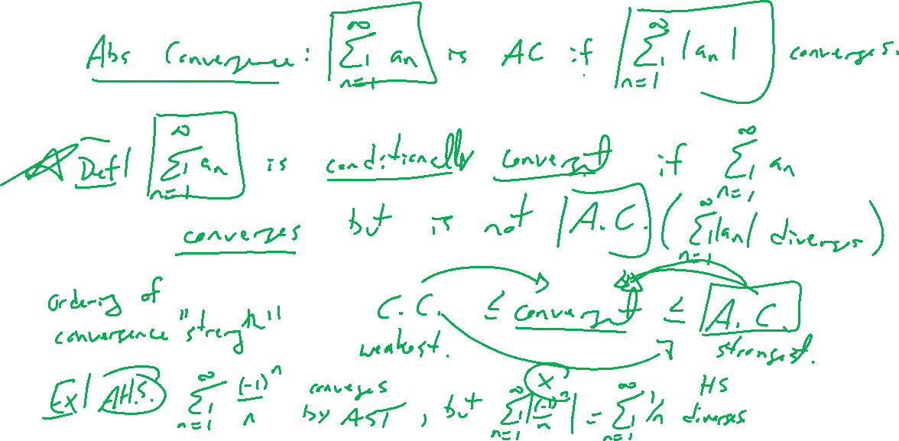
Conditional Convergence
Notes:
Def: If abs conv but not conv
Can you think of an example? Alt harmonic

Slide 7
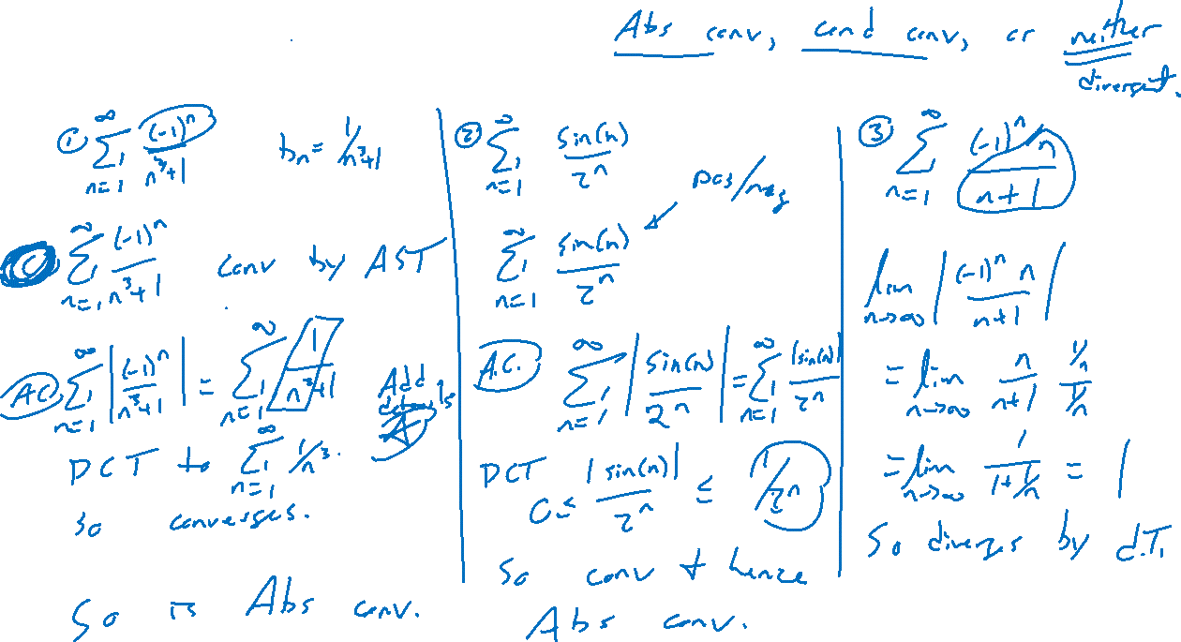
Examples: Try on Own
Notes:
State if abs conv, conditionally conv, or niether
(-1)^n/(n^3+1) ; sin(n)/2^n ; n(-1)^n / n+1

Slide 8
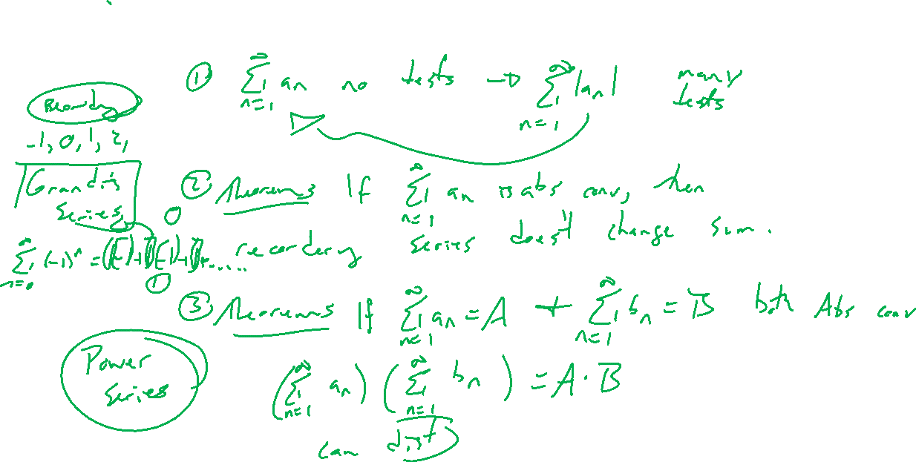
Advantage of Absolute Convergence
Notes:
Theorem: if \sum a_n abs conv, can reorder summation
Thoerem: If \sum a_n = A, \sum b_n = B abs conv, can multiply series (\sum a_n)(\sum b_n) converges to A*B
This hints about \sum (-1)^n being able to reorder to get anything.
https://en.wikipedia.org/wiki/Grandi%27s_series

